Slide 1
DevOps ext program Winter 2020-2021
Creating basic DevOps chain connecting local machine, GitHub repository, Jenkins and GCP instance.
Andrii Kozak

Slide 2
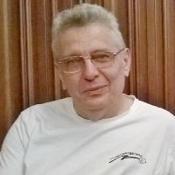
Whoami
I was born and grew up in the pretty town in the Ukraine. Time stopped in this town.
I graduated from Kiev University with a degree in applied mathematics.
The topic of my thesis: solving one dynamic problem by the finite elements method.
After university I worked in Ivano-Frankivsk at a factory in the ACS department. I was a Software Engineer on PDP-11 computers. I think, PDP-11 computers were the best computers of all time.
I programmed in various programming languages while was studying in the University and was working at the ACS.
I worked for the Elcom Company.
After Elcom, I had worked for the ITC LLC as a lead manager for almost twenty years.
And finally I worked for the firm Kopiyochka in the IT department.
Now I'm looking for a job that I like.
Before I went on the Epam course, I had studied on the SoftServe IT Academy course: Flexible methodologies of developing automated configuration management.
I am a quick learner and master new technologies.
I like read books. My favorite writer is Sir Terence David John Pratchett.
My favorite television series is Lexx.
My favorite number is 1729, the third Carmichael number.
I like steamships and hydrofoils.

Slide 3
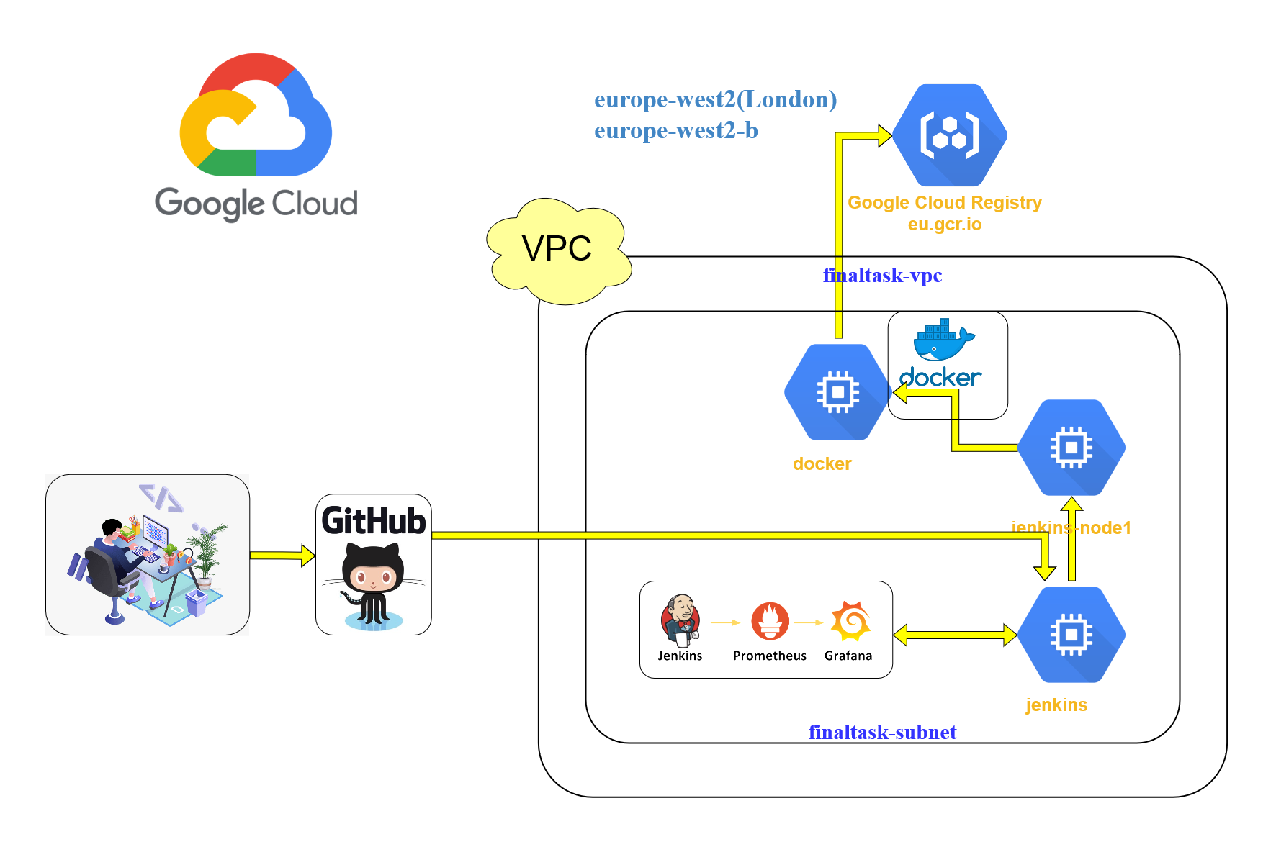
Final task diagram

Slide 4
Task descriptions
In this project we created automated process for fast deployment site to server after changes.
In project we used:
Google Cloud Platform;
GitHub is a provider of Internet hosting for software development and version control using Git;
Jenkins is a free and open source automation server;
Terraform is an open-source infrastructure as code software tool created by HashiCorp;
Bash scripts;
Docker is a set of platform as a service (PaaS) products that use OS-level virtualization to deliver software in packages called containers.
docker-compose;
Django is a Python-based free and open-source web framework that follows the model-template-views (MTV) architectural pattern;
Prometheus is a free software application used for event monitoring and alerting;
Grafana is a multi-platform open source analytics and interactive visualization web application;
GCR.IO - Container Registry is a single place for team to manage Docker images.

Slide 5
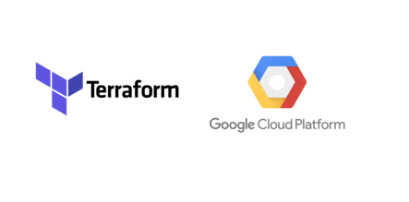
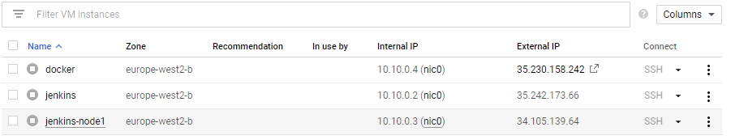
Terraform
main.tf – create VPC, Subnetwork, VPC firewall configuration.
docker.tf – create docker instance ( docker.sh – install docker, docker-compose).
jenkins.tf – create jenkins instance ( jenkins.sh –install Java, jenkins, docker, docker-compose).
Jenkins-node1.tf – create jenkins-node1 instance ( jenkins-node1.sh – install Java).
All instances have static IP.

Slide 6
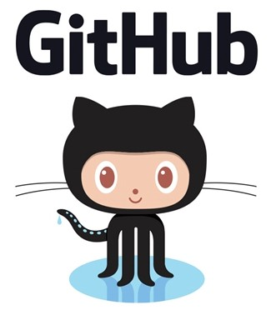
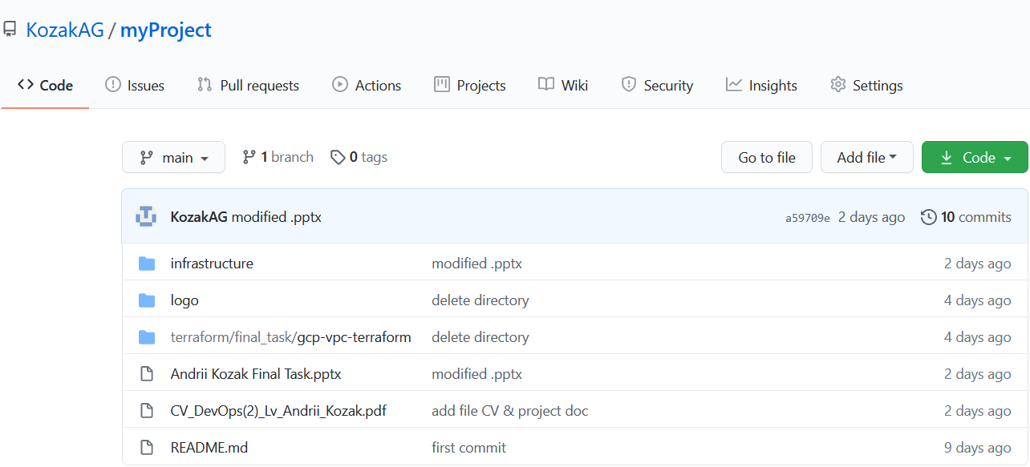
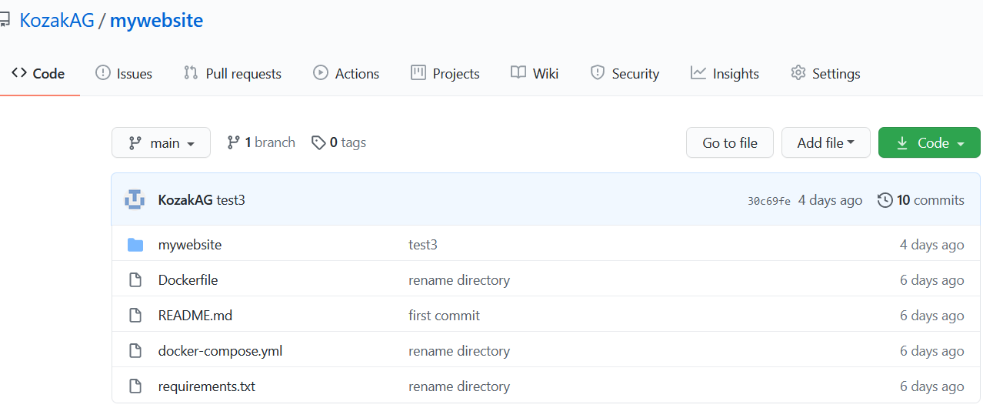
GitHub
We create the following repositories:

Slide 7
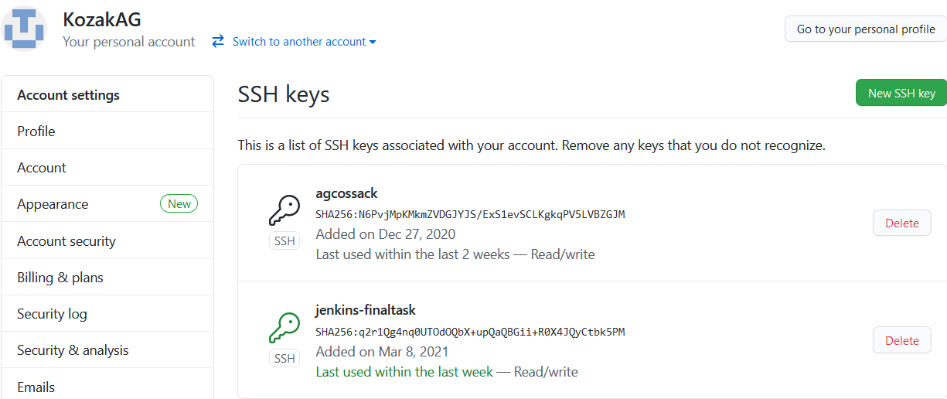
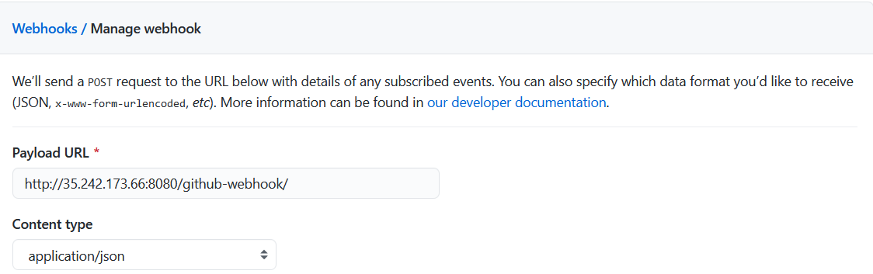
GitHub
We add the ssh keys to the repository:
We add webhook to the repository

Slide 8

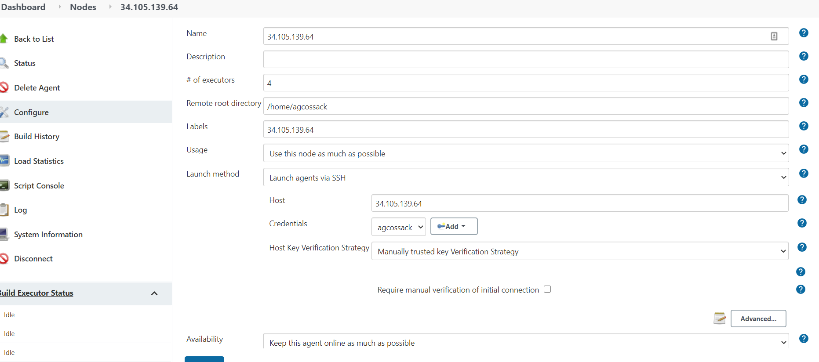
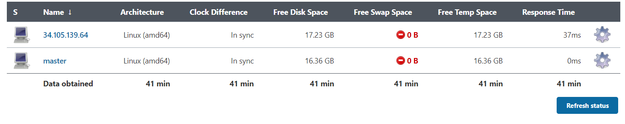
Jenkins
Configure node1 (slave)

Slide 9
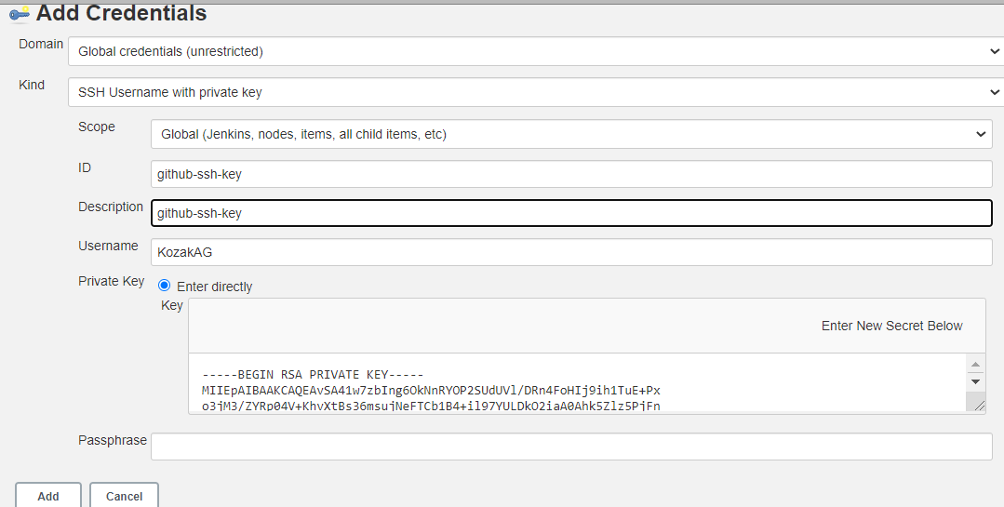
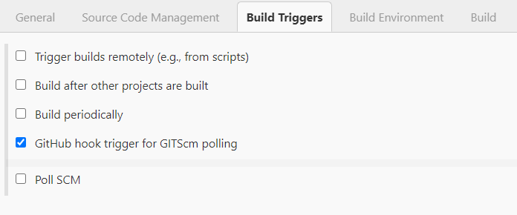
Jenkins
Configure our job: finaltask.

Slide 10
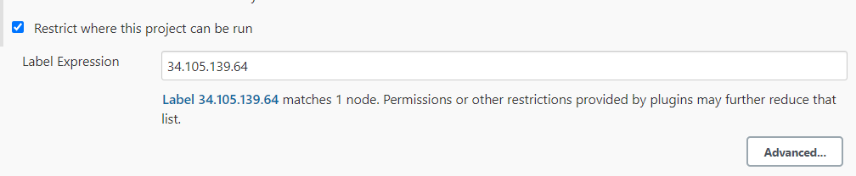
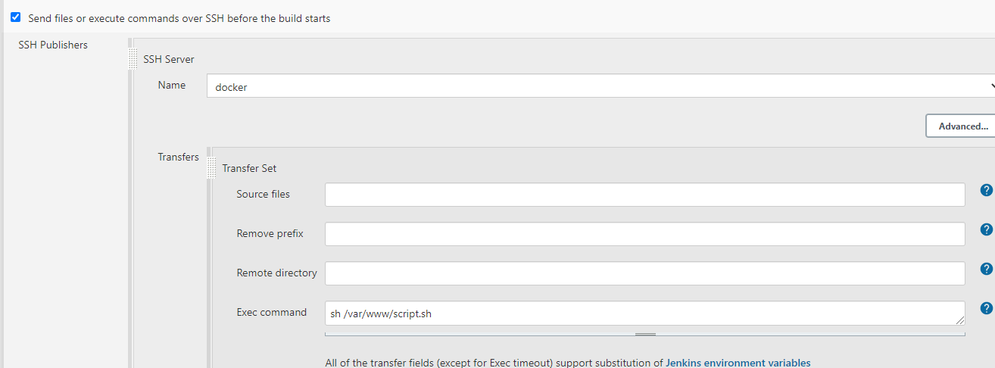
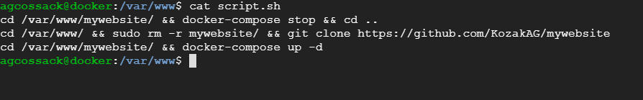
Jenkins
Configure our job: finaltask.

Slide 11

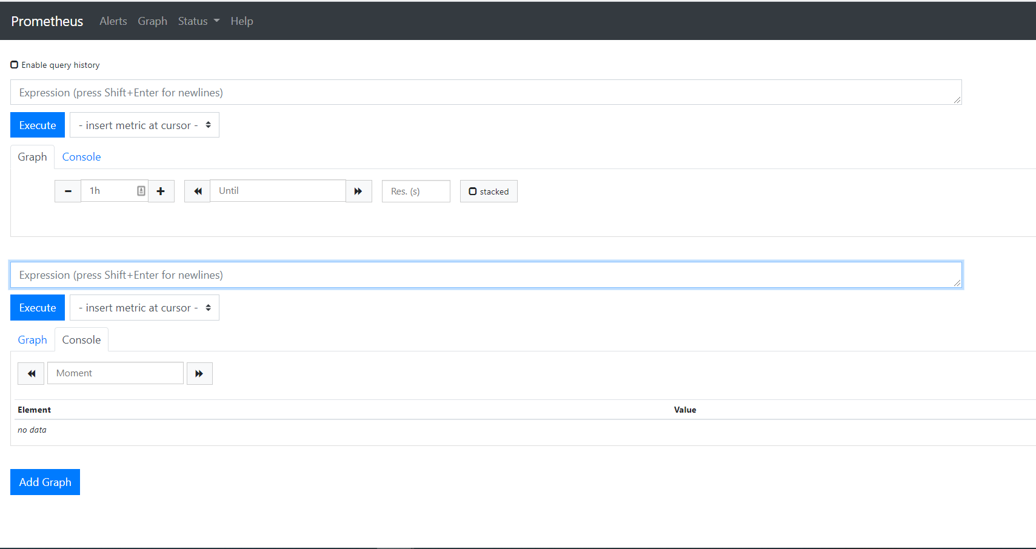
Prometheus

Slide 12

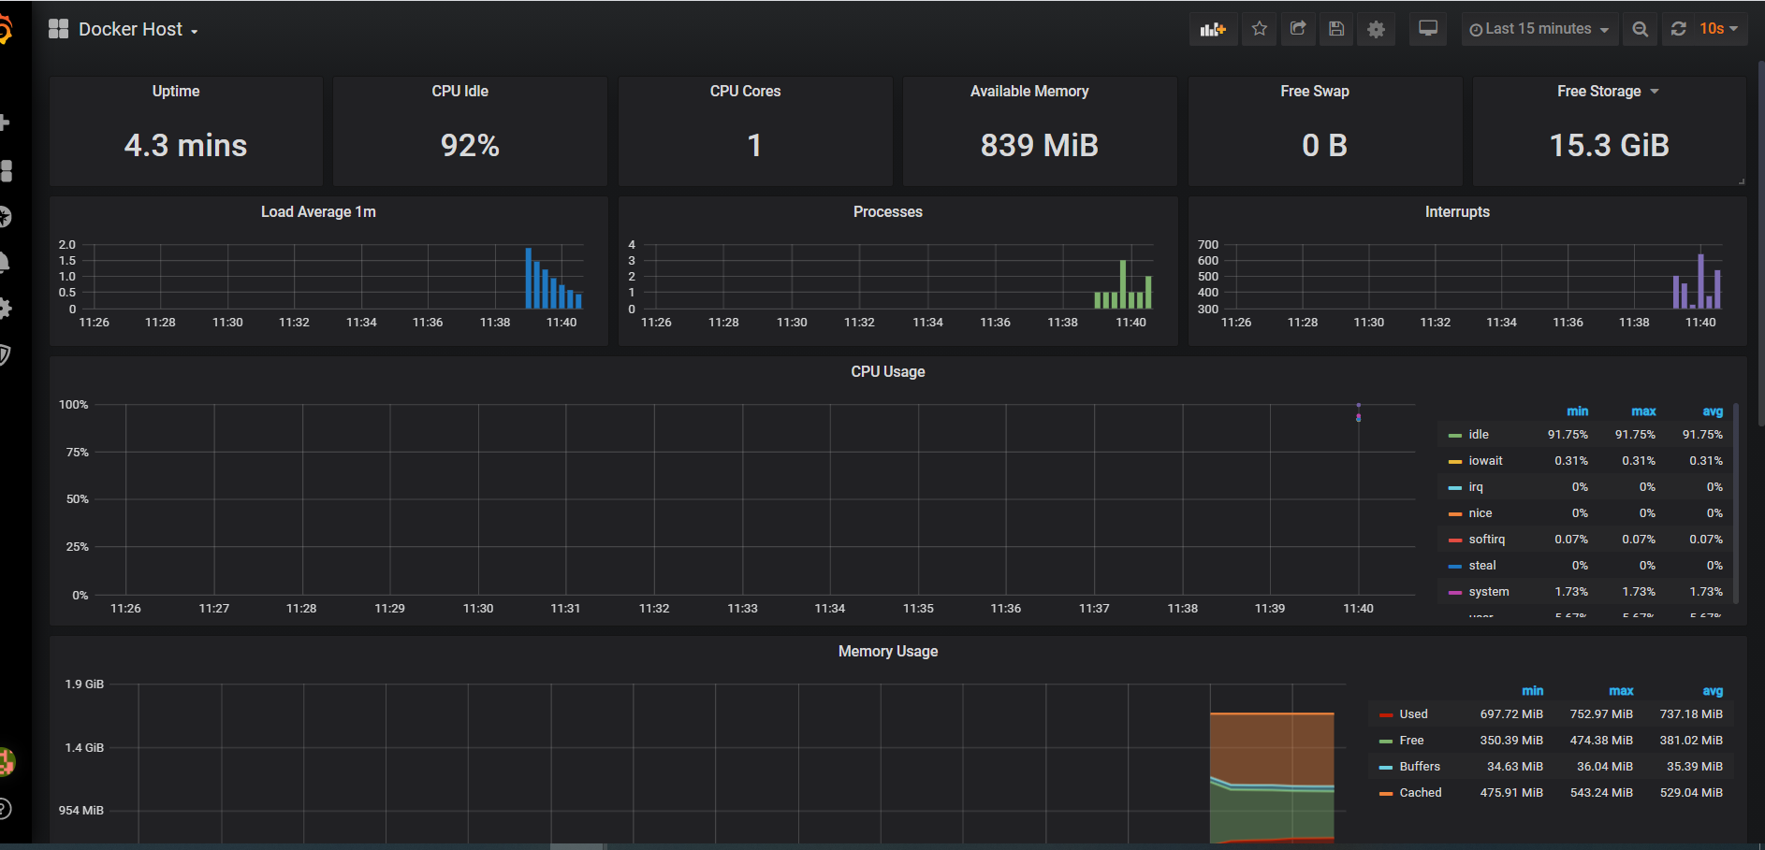
Grafana

Slide 13
Prometheus + Grafana install
We will use Einsteinish/Docker-Compose-Prometheus-and-Grafana, which includes Prometheus, Grafana, cAdvisor, NodeExporter and AlertManager.
Clone the repository and run the installation:
git clone https://github.com/Einsteinish/Docker-Compose-Prometheus-and-Grafana.git
cd Docker-Compose-Prometheus-and-Grafana
docker-compose up -d

Slide 14
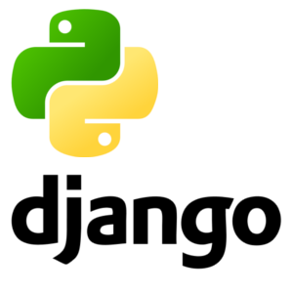
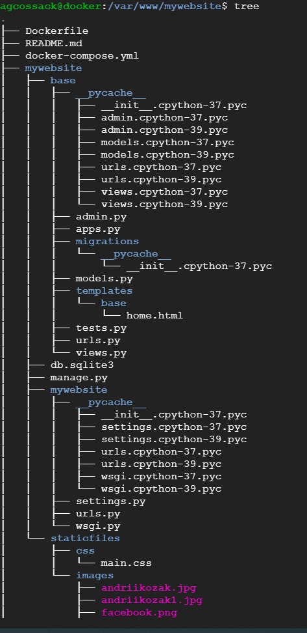
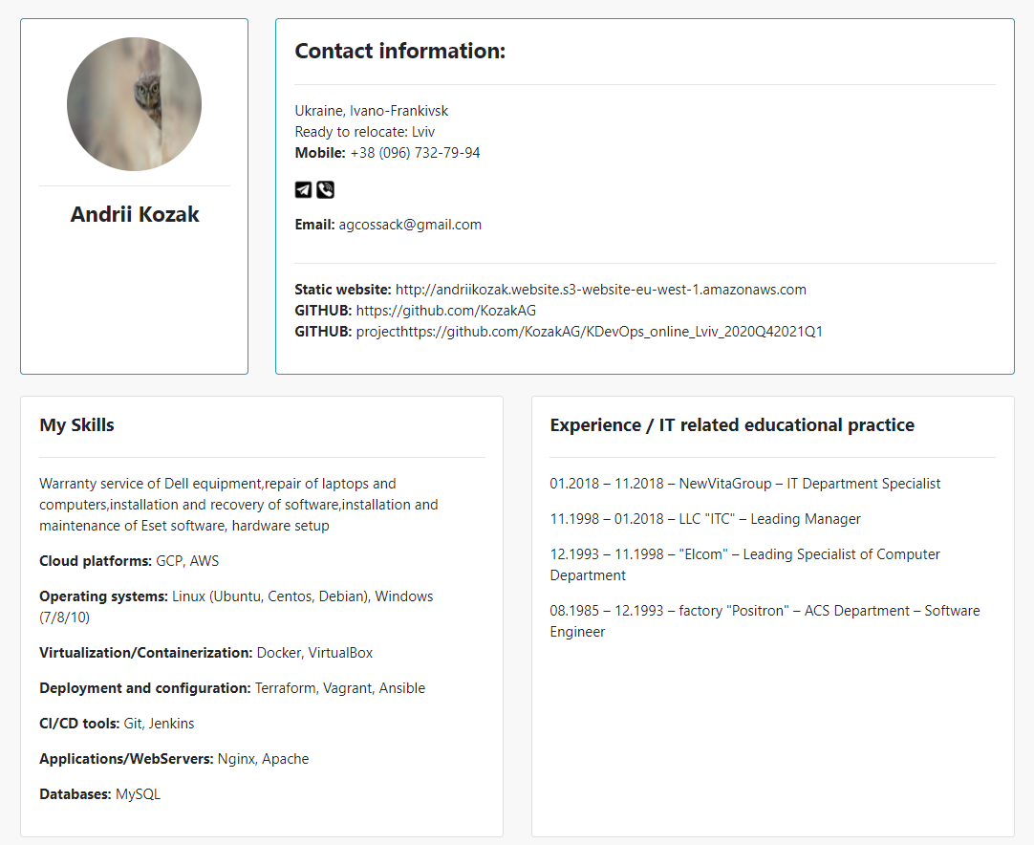
Django

Slide 15
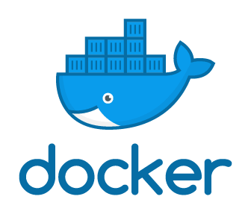
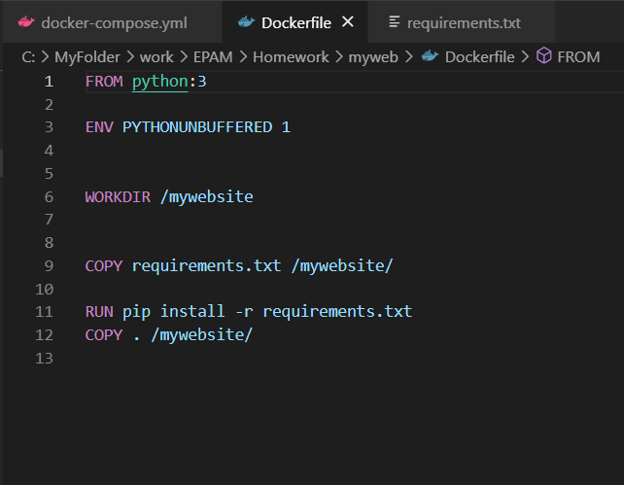
Docker
Add the following content to the Dockerfile.
This Dockerfile starts with a Python 3 parent image. The parent image is modified by adding a new code directory.

Slide 16
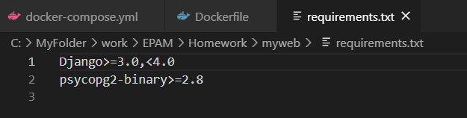
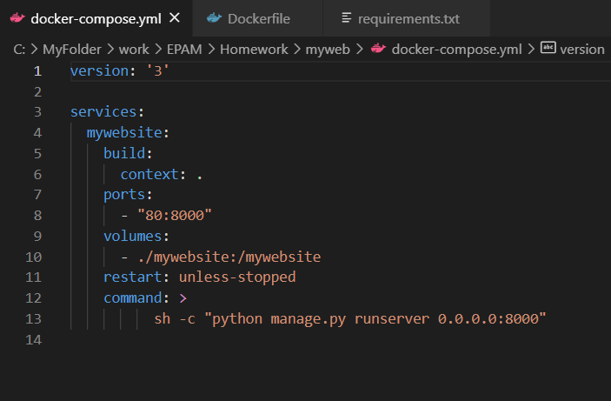
Docker
The parent image is further modified by installing the Python requirements defined in the requirements.txt file.
The docker-compose.yml file describes the services that make our app. In this example those service is a web server.
The compose file also describes which Docker image this service use, which volume need to be mounted inside the container.
Finally, the docker-compose.yml file describes which ports this service expose.

Slide 17
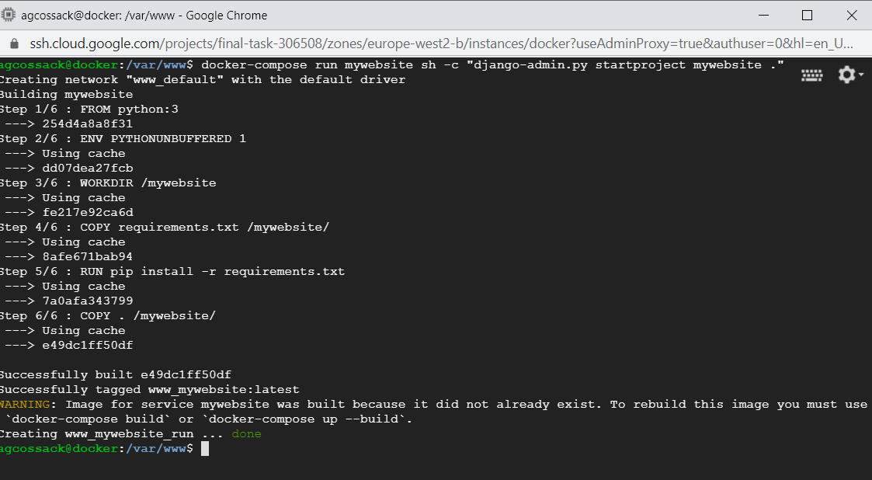
Docker
We create the Django project by running the docker-compose run command as follows.

Slide 18
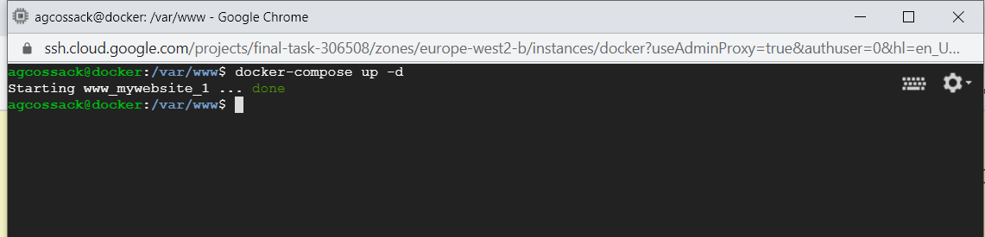
Docker
Change the ownership of the new files.
sudo chown -R $USER:$USER .
Run the docker-compose up command from the top level directory for your project.
docker-compose up -d

Slide 19
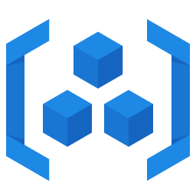
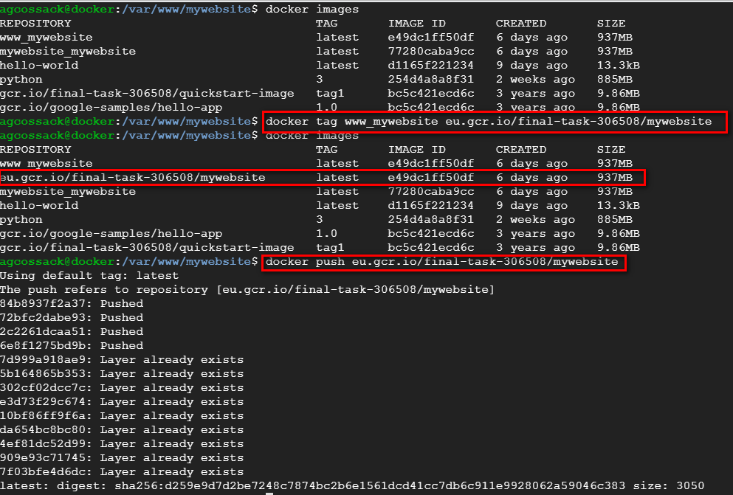
GCR.IO
Container Registry is a single place for team to manage Docker images, perform vulnerability analysis, and decide who can access what with access control. Existing CI/CD integrations let you set up fully automated Docker pipelines to get fast feedback.

Slide 20
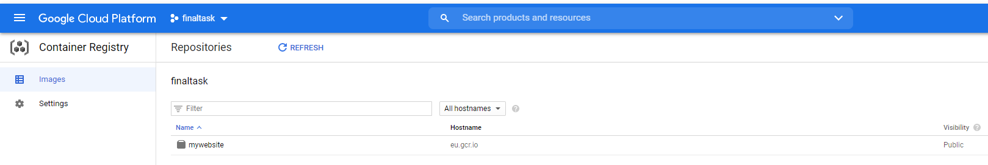
GCR.IO

Slide 21
Thanks for attention!
Student: Andrii Kozak
Email: agcossack@gmail.com

